Slide 1
A Seminar on Multi-authority Attribute-based Keyword Search Over Encrypted Cloud Data
Team No. : 05
L. Sai Kethana (20EG105127)
M. Uday Sai Kiran (20EG105128)
N. Meghan Satwik (20EG105134)
P. Keerthipriya (20EG105141)
Project Supervisor
Mr. Madar Bandu
Assistant Professor

Slide 2
Introduction
In the era of pervasive cloud computing, where vast amounts of sensitive data are stored remotely, ensuring the confidentiality and privacy of this information has become a paramount concern.
Many industries, including healthcare, finance, and government, are increasingly relying on cloud storage for data management, but the need to safeguard against unauthorized access has led to the exploration of advanced cryptographic techniques. One critical aspect of secure data management in the cloud is the ability to perform efficient keyword searches over encrypted data, particularly in scenarios involving multiple authorities responsible for managing different attributes.

Slide 3
Problem Statement
To develop a project that introduces a Searchable Encryption scheme which can simultaneously enable users to search over outsourced encrypted data with only relevant encrypted documents which can only accessed by the authorized users.

Slide 4
Problem Illustration
Most of the existing schemes do not support keyword searching schemes. In such cases, data users must download, filter and process a large amount of data in order to get relevant results, which obviously lack practicality.
Also the outsourced data can be accessed by the other users which may leads to compromise the confidentiality and integrity of the data.
To address this challenge, this project introduces a Searchable Encryption scheme which can simultaneously enable users to search over outsourced encrypted data with only relevant encrypted documents.

Slide 5
Proposed Method
The proposed secure Multi-authority CP-ABKS (MABKS) system will address such limitations and minimize the computation and storage burden on resource-limited devices in cloud systems. In addition, the MABKS system is extended to support malicious attribute authority tracing and attribute update and supports to avoid performance bottleneck at a single point in cloud systems. Our rigorous security analysis shows that the MABKS system is selectively secure in both selective-matrix and selective-attribute models.
The proposed system allows data owners to control the search permission for their outsourced encrypted data according to an access control policy. As long as his attributes satisfy the access control policy, any user can perform a keyword search. This means that our primitive supports multiuser search. In addition, every user with a set of attributes can generate a delegated key for another user who has a more restricted set of attributes.

Slide 6
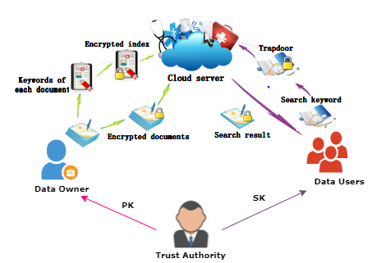
Proposed Method Illustration
The proposed system model consists of four entities. The data owner and data user will be registered with this system.
Later, the trusted authority will generate the public key and private keys for data users. So, the data owner will encrypt the file data using the public key, and, apply the access policy with the user’s attributes over the encrypted data, thereafter uploading this encrypted data to the cloud server along with keywords.
The users will send keyword requests to the cloud server, then the cloud server will return the encrypted files to the users based on matched keywords. If the user’s attributes satisfy the access policy, then they will decrypt those encrypted files with a private key. Otherwise, they are denied to access those files.

Slide 7
Proposed Method Illustration
Consider a scenario where a healthcare organization stores sensitive patient records in the cloud. The organization may have multiple authorities responsible for different aspects of patient data, such as medical history, billing information, and diagnostic reports. Each authority is responsible for assigning attributes to control access to relevant portions of the data.
Now, imagine a patient wants to search for specific medical records related to a particular diagnosis without revealing the actual content of the records. Additionally, he wants to ensure that only authorized authorities can access the corresponding information.

Slide 8
Proposed Method Illustration
Data Encryption:- The patient records are encrypted before being stored in the cloud to protect sensitive information from unauthorized access.
Attribute-Based Access Control:- Different authorities assign attributes to the encrypted data. For instance, the medical history authority may assign attributes related to medical conditions, while the billing authority assigns attributes related to financial transactions.
Keyword Search:- If patient wants to search for records related to a specific medical condition, using keywords, without decrypting the data. Only the relevant authorities can access the decrypted results.

Slide 9
Experiment Environment
Software Requirements:-
Technology : Java 1.8
Operating System : Windows
Client-side lang : HTML, CSS, JavaScript
Web Server : Apache Tomcat 8
Server-side lang : JSP
Database : MySQL 5.5
IDE : Visual Studio Code
Hardware Requirements:-
Processor : Any updated processor
RAM : Min 1 GB
Hard Disk : Min 100 GB

Slide 10
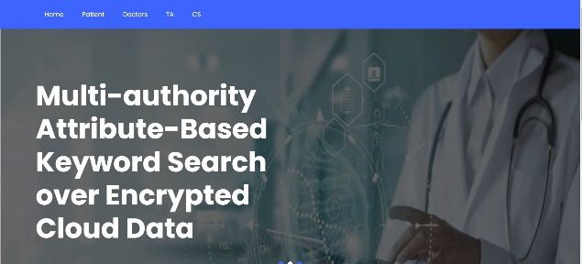
Experiment Screen shorts
Fig 1. Home page

Slide 11
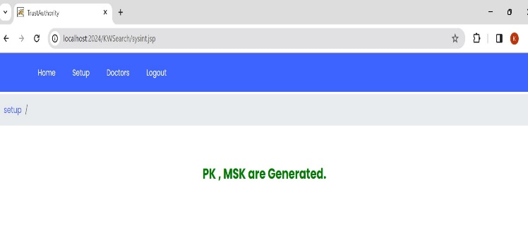
Experiment Screen shorts
Fig 2. Generation of public and master keys by trusted authority

Slide 12
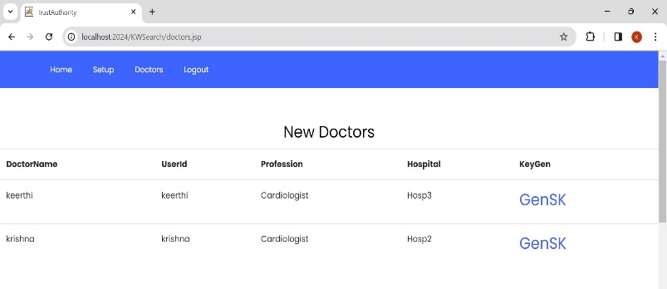
Experiment Screen shorts
Fig 3. Generation of secret keys for doctors using attributes

Slide 13
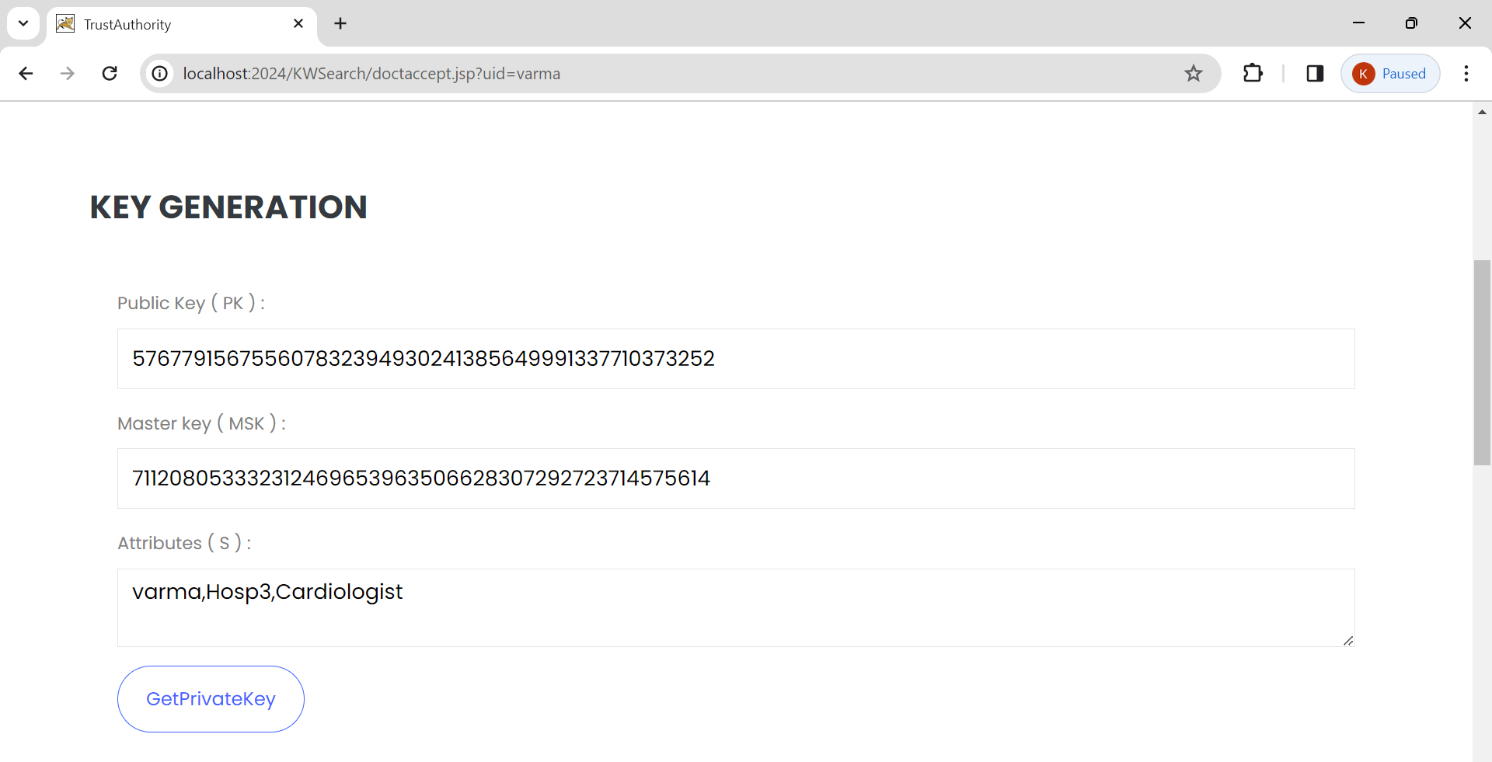
Experiment Screen shorts
Fig 4. Secret key generation for doctors using attributes

Slide 14
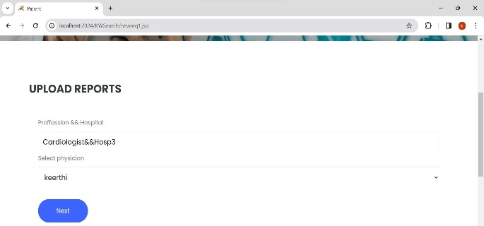
Experiment Screen shorts
Fig 5. Patient uploads data to specific doctor

Slide 15
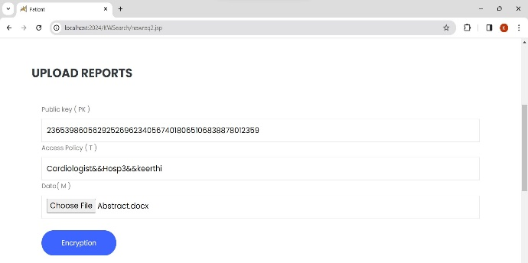
Experiment Screen shorts
Fig 6. Data files are encrypted using access control policy

Slide 16
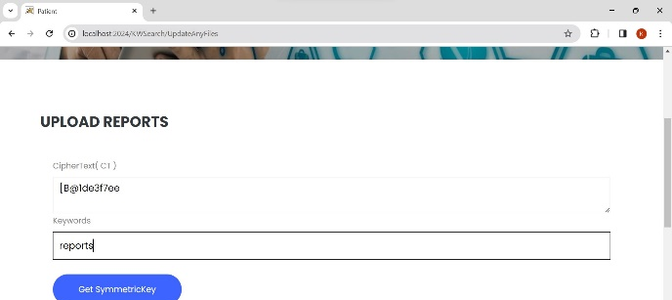
Experiment Screen shorts
Fig 7. Generating symmetric key using keyword

Slide 17
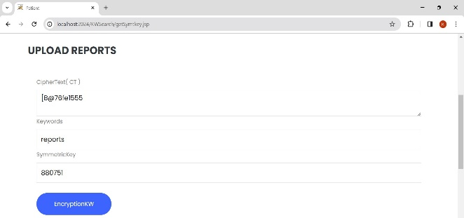
Experiment Screen shorts
Fig 8. Encryption of keyword using symmetric key

Slide 18
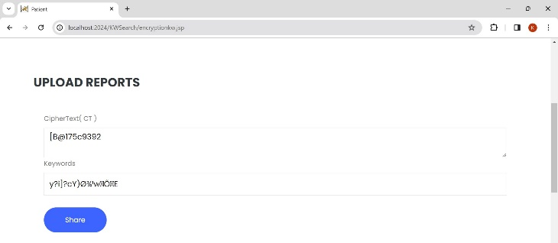
Experiment Results
Fig 9. Patient sharing the data files with the doctor

Slide 19
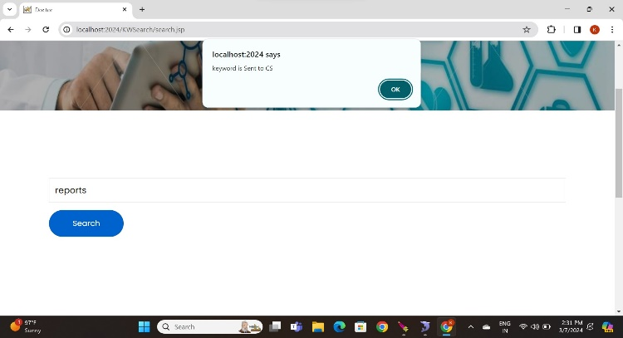
Experiment Results
Fig 10. Doctor searches patient’s data using keywords

Slide 20
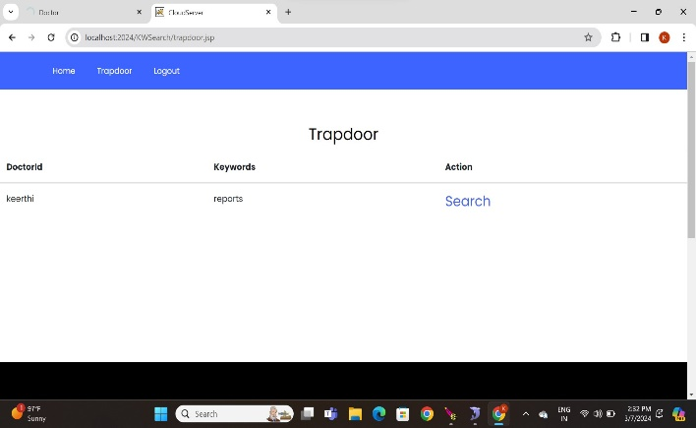
Experiment Results
Fig 11. Cloud server search the keyword in the database and return the matched data to the doctor

Slide 21
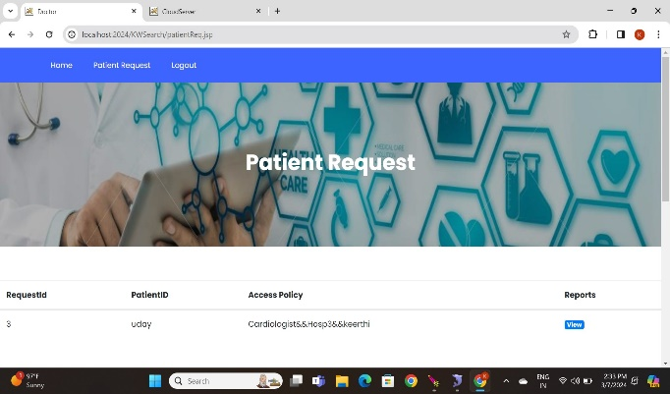
Experiment Results
Fig 12. If the access policy satisfies, the doctor can view the encrypted data file

Slide 22
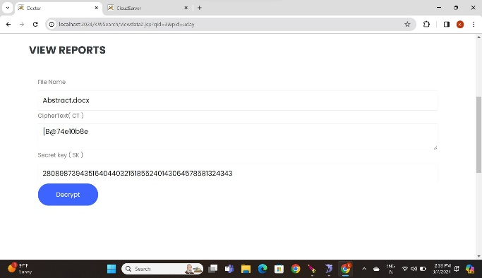
Experiment Results
Fig 13. Using secret key doctor can decrypt the encrypted data file

Slide 23
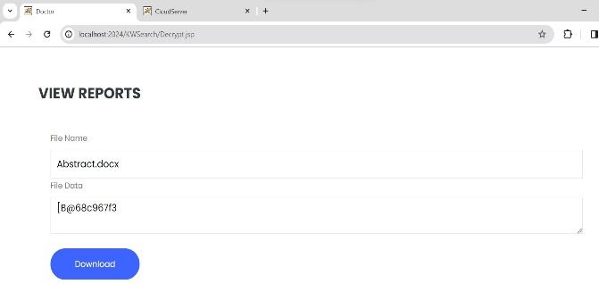
Experiment Results
Fig 14. Doctor can download the data file now

Slide 24
Justification
The parameters improved by using our method
Privacy Preservation: MA-ABKS employs encryption techniques, such as attribute-based encryption (ABE), to ensure that data remains encrypted even during search operations. This prevents unauthorized access to plaintext data by the cloud service provider or any unauthorized entities.
Fine-Grained Access Control: MA-ABKS provides finer-grained access control compared to other traditional approaches. With attribute-based access control, users can specify access policies based on attributes rather than just keywords, allowing for more precise control over who can access what data.
Flexibility: MA-ABKS offers greater flexibility in defining access policies and managing attributes. It supports complex access structures based on multiple attributes and authorities, enabling more sophisticated access control scenarios compared to other traditional methods.

Slide 25
Justification
The parameters improved by using our method
Attribute Updates : Another improvement is the support for attribute updates within the system. This feature ensures that outdated secret keys cannot be exploited for unauthorized access, thereby maintaining data integrity and security.
Performance : Through performance evaluation, the project showcases notable reductions in computation and storage costs compared to previous Attribute-Based Keyword Search (ABKS) schemes. This optimization enhances the system's efficiency and resource utilization.
Search : Keyword search plays a crucial role in enabling users to securely retrieve relevant information from the cloud while preserving data confidentiality.

Slide 26
Thank you!

